Slide 1
Performance Analysis and Optimization of R245fa-Cyclopentane Zeotropic Mixtures in Partial Evaporating Organic Rankine Cycles (PEORC) for Low Temperature Heat Recovery
Anandu Surendran
Satyanarayanan Seshadri Ph.D
Energy and Emissions Lab
Department of Applied Mechanics
Indian Institute of Technology| Madras

Slide 2
What is proposed ?
For low temperature ORC applications, maximum heat recovery and power output are critical
Recent developments in highly efficient screw, scroll and other volumetric expanders makes partial evaporation possible
Hydrocarbons like cyclopentane used in medium to high temperature applications present excellent heat absorbing characteristics but are limited by their flammability
Partial evaporation
Improved heat source utilization
Lower thermal efficiency
Alkane-refrigerant zeotropes
Improved latent heat capacity
Higher temperature glide
Improved thermal efficiency
Higher power output
Higher power output
Higher thermal efficiency
Improved heat source utilization
+

Slide 3
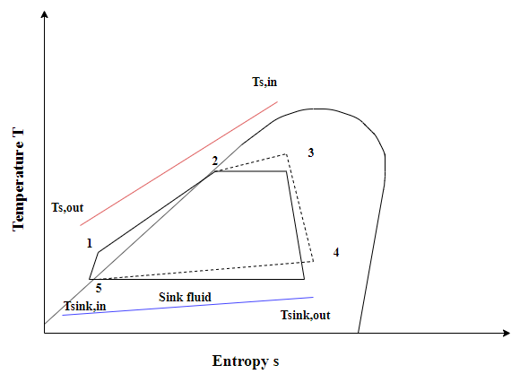
Working fluid characteristics
Partial evaporating ORC
Working fluid is not fully evaporated
Exits the evaporator as a 2 –phase mixture
Uses scroll, screw and other volumetric expanders
Cyclopentane- high latent heat
R245fa has lower condensing temperatures
R245fa-cyclopentane mixture has high temperature glide and latent heat
T-s diagram of PEORC
Temperature glide and latent heat variation with mass fraction of R245fa
Working fluid | Molecular mass (g/mol) | Normal boiling point(K) | Critical temperatureT_{c} (K) | Critical pressure P_{c}(MPa) | GWP | ODP
R245fa | 134.05 | 288.29 | 427.16 | 3.651 | 1030 | 0
Cyclopentane | 70.133 | 322.40 | 511.69 | 4.515 | 11 | 0

Slide 4
Heat source and Cycle parameters
Parameter |  | Value
Heat source (water) inlet temperatures | T_{s,in} (K) | 363-423
Heat source mass flow rate | m_{s} (kg/s) | 1
ΔT pinch evaporator | ΔT_{evap} (K) | 5
ΔT pinch condenser | ΔT_{cond} (K) | 5
Isentropic expander efficiency | η_{e} (%) | 70 (Lecompte et al. , 2013)
Isentropic pump efficiency | η_{p} (%) | 80 (Shu et al., 2014)
Inlet temperature cooling water | T_{sink, in} (K) | 298
Outlet temperature cooling water | T_{sink, out} (K) | 303
Ambient temperature | T₀ (K) | 298
Ambient pressure | P₀ (MPa) | 0.1
The influence of vapour fraction and mixture composition on the performance of PEORC is analysed
The condensing dew point temperature is fixed at 318K
The evaporating bubble point temperature T₂ is optimized in each case for maximum power output
For mixtures and pure R245fa, the maximum evaporating bubble point temperature is restricted to 0.9T_{c} of R245fa. For pure cyclopentane, this constraint is set to 0.90T_{c} of cyclopentane
PEORC performance is compared with Trilateral cycle (TLC) and subcritical ORC (SORC)

Slide 5
Energy Analysis
Effect of vapour quality and mass fraction of R245fa on (a) Thermal efficiency (b) Heat source utilization rate and (c) Net power output
The thermal efficiency of PEORC using mixtures exceeds that of SORC and TLC for certain mass fractions
Also, the thermal efficiency of mixtures is higher than that of pure fluids for certain mass fractions of R245fa
Mixtures achieve the highest heat source utilization, more than pure fluids in PEORC
Mixtures in PEORC mode also achieve the highest power output

Slide 6
Exergy Analysis
Internal second law efficiency External second law efficiency
At lower vapour fractions, mixtures exhibit high internal second law efficiencies than that of pure fluids.
High external second law efficiencies are obtained for mixtures and pure fluids owing to the shift in temperature pinch point in the evaporator, which allows for increased heat extraction.
There is a vapour fraction that minimises the evaporator irreversibility, thereby leading to high internal second law efficiencies.
Both mass fraction and vapour quality can be optimized

Slide 7
Heat exchanger and expander size requirements
Variation in KA Variation in expander volume coefficient
Mixtures in PEORC mode show the highest KA requirements
SORC shows the minimum overall KA requirement for all the cases
The higher specific volumes when using mixtures containing cyclopentane contribute to higher expander coefficients than pure R254fa
The two phase expanders used in mixtures based PEORCs are associated with higher sizes and costs than the turbine expanders used in SORCs

Slide 8
Optimization : range and constraints
Cycle Parameters/ constraints | Range/Value
Evaporating bubble point temperature T₂ | 323-393K
Condenser dew point temperature T_{cond} | 308K – 333K
Mass fraction of R245fa x | 0.01-0.99
Vapor quality q | 0.01-0.99
P_{cond} | >= 1.50 bar
GA parameters
Population size | 40
Maximum generations | 400
Function tolerance | 0.001
For the PEORC with mixtures, the optimization parameters are the evaporating bubble point temperature T₂, the vapor quality q, mass fraction of R245fa x and condensing dew point temperature T₆
For mixtures and pure R245fa, the maximum evaporating bubble point temperature is restricted to 0.9 T_{c} of R245fa
For pure cyclopentane, this constraint is set to 0.9 T_{c} of cyclopentane
The condenser pressure is kept above atmospheric pressure to prevent air leakage into the system
The cycle parameters are optimized using Genetic Algorithm (GA). Net power output is selected as the objective function
The optimized cycle performance is then compared with optimized performance of SORC and TLC operating with pure R245fa for three typical low heat source temperatures of 363K, 393K and 423K

Slide 9
Genetic Algorithm Optimization: Results for 363-423K heat sources
36-65% for more power compared to SORC with pure R245fa
3-5% higher power output than PEORC with pure R245fa
PEORC with pure R245fa exhibits intermediate KA values, 7-8% and 4-18% lower than PEORC and TLC using mixtures
The VC values associated with pure R245fa in PEORC are also lower (7-12% and 15-43% lower than that of PEORC using mixtures and TLC using mixtures)

Slide 10
Summary and Conclusions
At lower vapour fractions, PEORC with mixtures achieve the highest net power output and heat source utilization rates
Heat exchanger requirements and expander economy of PEORC using mixtures is quite poor when compared with SORC
Under optimized conditions, PEORC with mixtures deliver 36-65% for more power output when compared with SORC with pure R245fa for the heat source temperatures investigated
As heat source temperature increases, PEORC with mixtures show a decrease in relative performance over SORC with R245fa.
Furthermore, PEORC with mixtures present only 3-5% higher power output than PEORC with pure R245fa. PEORC with pure R245fa also exhibits intermediate KA values, 7-8% and 4-18% lower than PEORC and TLC using mixtures
Overall, PEORC with R245fa shows promising system performance than that of mixtures

Slide 11
Thank you....

Slide 12
References
G. Shu, Y. Gao, H. Tian, H. Wei, and X. Liang, “Study of mixtures based on hydrocarbons used in ORC (Organic Rankine Cycle) for engine waste heat recovery,” 2014
H. Zhai, Q. An, L. Shi, V. Lemort, and S. Quoilin, “Categorization and analysis of heat sources for organic Rankine cycle systems,” Renew. Sustain. Energy Rev., vol. 64, pp. 790–805, 2016.
J.-C. Chang, T.-C. Hung, Y.-L. He, and W. Zhang, “Experimental study on low-temperature organic Rankine cycle utilizing scroll type expander,” Appl. Energy, vol. 155, pp. 150–159, 2015.
J. G. Andreasen, U. Larsen, T. Knudsen, L. Pierobon, and F. Haglind, “Selection and optimization of pure and mixed working fluids for low grade heat utilization using organic rankine cycles,” Energy, vol. 73, pp. 204–213, 2014.
L. S. * Van Den Broek and D. Paepe, “Thermodynamic analysis of the partially evaporating trilateral cycle.”
M. Imran, M. Usman, B. Park, and D. Lee, “Volumetric expanders for low grade heat and waste heat recovery applications,” Renew. Sustain. Energy Rev., vol. 57, pp. 1090–1109, 2016.
R. Radermacher and Y. Hwang, Vapor Compression Heat Pumps with Refrigerant Mixtures. 2005.
S. Lecompte, H. Huisseune, M. Van Den Broek, and M. De Paepe, “Methodical thermodynamic analysis and regression models of organic Rankine cycle architectures for waste heat recovery,” Energy, vol. 87, pp. 60–76, 2015.
Y. Zhou, F. Zhang, and L. Yu, “Performance analysis of the partial evaporating organic Rankine cycle (PEORC) using zeotropic mixtures,” Energy Convers. Manag., vol. 129, pp. 89–99, 2016.

Slide 13
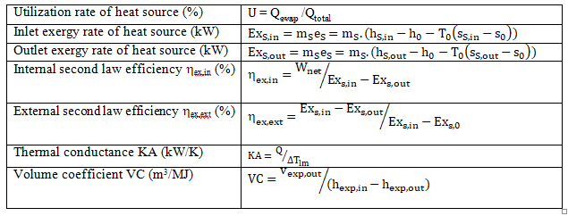
Appendix 1: Modeling equations
Steady state model developed in MATLAB using thermodynamic properties of fluids from REFPROP® 9.1 software
The vapour quality q can be between 0 and 1, with 0 being TLC and 1 being SORC
Also the mass fraction of R245fa can vary between 0 and 1, with 0 being pure cyclopentane and 1 being pure R245fa
For the PEORC with mixture, both vapour fraction and mass fraction would assume values between 0 and 1

