Slide 1
Potential of a Transcritical Regenerative Series Two Stage Organic Rankine Cycle for Dual Source Waste Heat Recovery
Anandu Surendran
Satyanarayanan Seshadri Ph.D
Energy and Emissions Lab
Department of Applied Mechanics
Indian Institute of Technology| Madras

Slide 2
Contents
Existing ORC architectures
Proposed architecture
Heat source and modelling conditions
Parameter studies
Optimization and comparison
Conclusion and future works

Slide 3
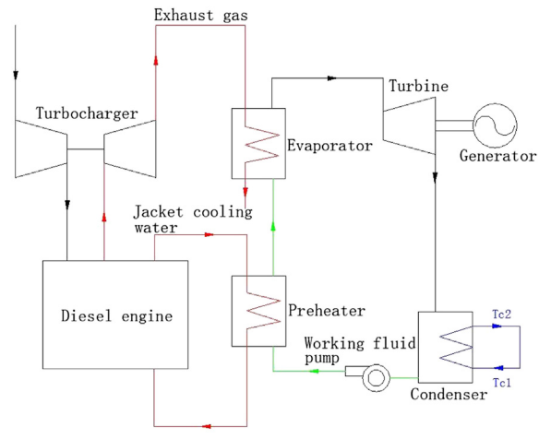
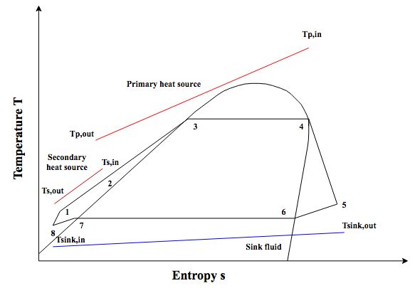
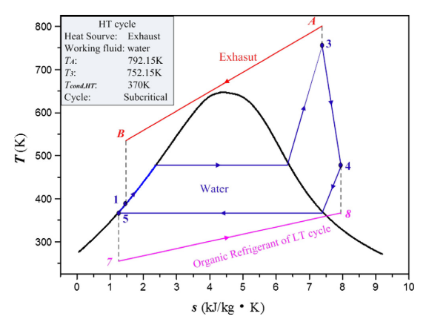
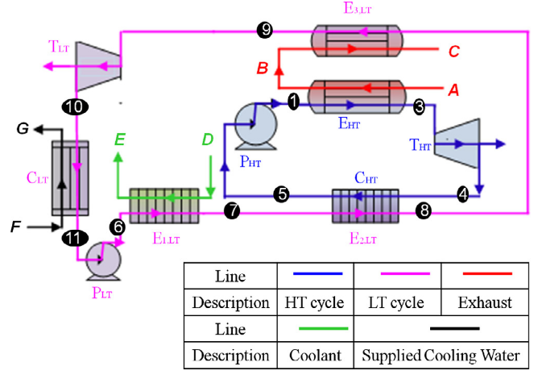
Existing ORC solutions
Pre-heated single stage ORC
Dual-loop ORC

Slide 4
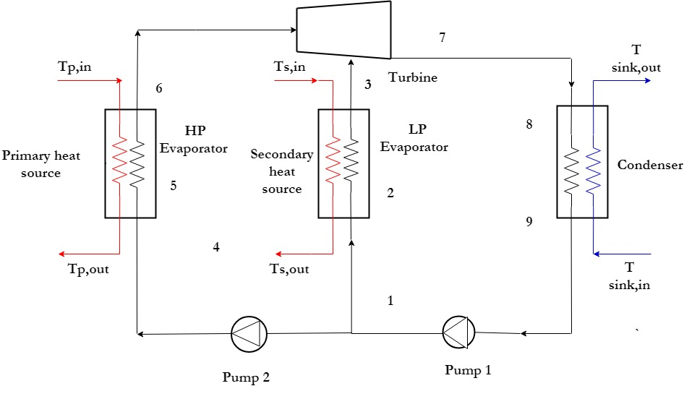
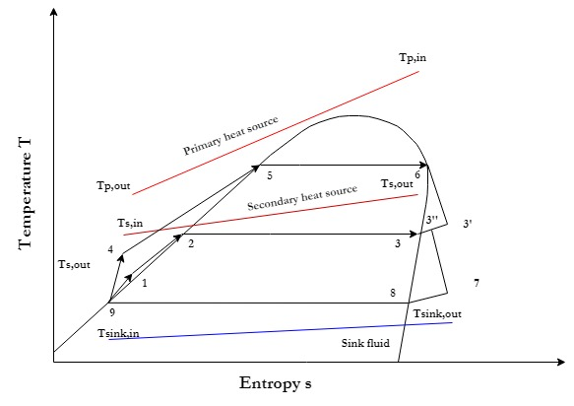
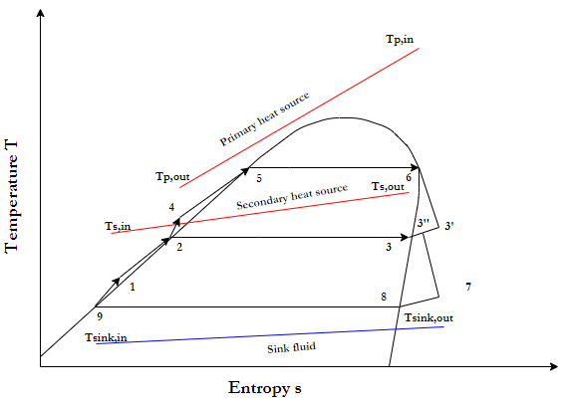
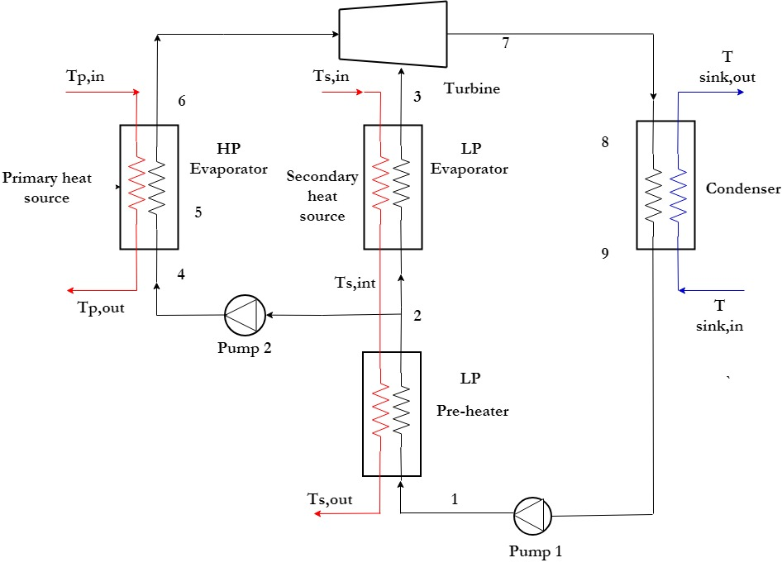
Parallel Two stage ORC (PTORC)
Series Two stage ORC (STORC)

Slide 5
Why advanced ORC architectures for more than one heat source ?
More often multiple heat sources exist concurrently
Existing complex architectures are less economical
All existing architectures are of lower thermal efficiency
Inability to fully utilize all the heat sources when multiples heat sources are present
What could be done?
Supercritical evaporation
Partial evaporation
Utilizing superheat after expansion
Reducing heat exchanger requirements
Stream splitting
ORC System

Slide 6
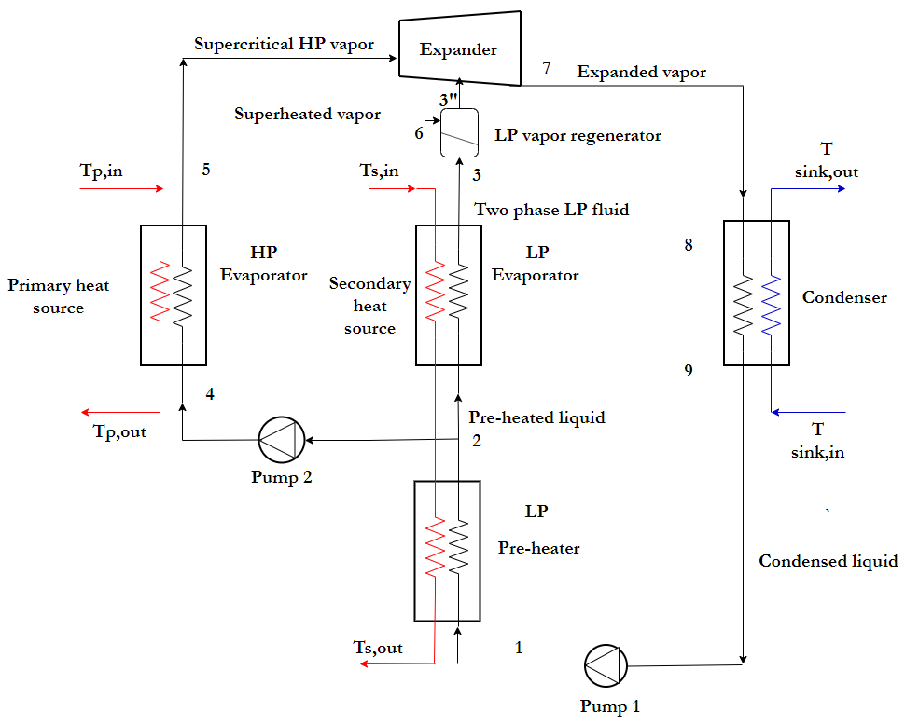
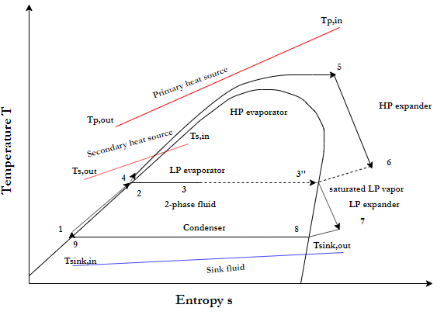
What is being proposed? An advanced ORC layout: Trans-critical Regenerative Series Two Stage Organic Rankine Cycle (TR-STORC)
Novel architecture that combines supercritical evaporation in high pressure (HP) stage and partial evaporation in low pressure (LP) stage
Utilizes the superheat of exhaust vapour from HP turbine in the regenerator to fully evaporate the working fluid in LP stage and boost power output
TR-STORC layout T-s diagram of TR-STORC

Slide 7
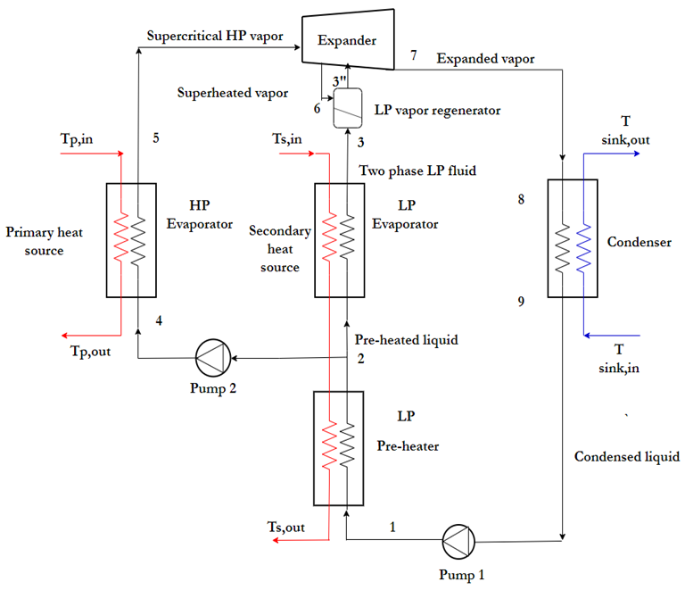
Heat source: Stationary IC Engine
2.9 MW natural gas engine
Used as stationary power generation units in steel plants and other process industries
Heat Sources from a Gas Engine
Engine jacket cooling water
Engine lubrication oil cooling
First stage air intake intercooler
Engine exhaust gases
Engine generator radiated heat
Heat from second stage intercooler
Exhaust gases
Hot water
First three are recovered as hot water on a 70/90°C flow return basis
Primary heat source : Exhaust gases (Tp= 432°C, mp=16,528 kg/h)
Secondary heat source : Hot water (Ts= 90°C, ms=50,400 kg/h)
Working fluid : Cyclopentane

Slide 8
Cycle parameters
Parameter |  | Value
ΔT pinch HP evaporator | ΔT_{evap,HP} (K) | 20
ΔT pinch LP evaporator | ΔT_{evap,LP} (K) | 10
ΔT pinch condenser | ΔT_{cond} (K) | 10
Isentropic expander efficiency | η_{e} (%) | 70
Isentropic pump efficiency | η_{p} (%) | 80
Primary heat carrier pressure | P_{P} (kPa) | 101.325
Primary heat source cooling limit | T_{P, outmin} (K) | 373
Inlet temperature cooling water | T_{sink, in} (K) | 298
Outlet temperature cooling water | T_{sink, out} (K) | 303
All processes are at steady state
Pressure drop and heat transfer from the pipelines is neglected
Changes in kinetic and potential energy of the working fluid is negligible
All heat exchangers are counter flow type
Both LP and HP turbine stages have same isentropic efficiency
MATLAB model integrated with REFPROP

Slide 9
Modelling equations and procedure
Discretized heat exchanger model with N=50 in HP evaporator for capturing the cooling curve and pinch point location
N=30 for condenser and LP evaporator
Mass flow rate in HP and LP loops are calculated iteratively
Search technique to find the optimum vapor fraction in LP evaporator outlet

Slide 10
Influence of HP evaporation pressure and vapor outlet temperature
At lower HP evaporator pressures, lower values of vapor outlet temperatures lead to maximum work output
For higher HP stage pressures ,the optimum vapor fraction is higher for a given vapour outlet temperature

Slide 11
Influence of HP evaporation pressure and vapor outlet temperature
Up remains almost constant with vapour outlet temperature
The peaks in Us correspond to maximum mass flow rates in the pre-heater section of LP evaporator
The variation in thermal efficiency is a direct result of the variation in net power output and heat source utilization rates

Slide 12
Influence of LP evaporation temperature (pressure)
At lower values of T₃, higher utilization of secondary heat is seen
At lower values of T₃, the thermal efficiency of the LP stage decreases resulting in lower power outputs
An intermediate value of T₃ exists that maximizes the net power output of the TR-STORC.

Slide 13
Cycle optimization : Parameters and Constraints
Parameter | Value
T₆ | 560-600K
T₃ | 323K –(T_{s,in} -ΔT_{evap,LP})K
P_{HP evap} | 1.1 P_{c}- 8MPa
T_{cond} | 313K-333K
Constraints
P_{cond} | 1.20 bar
VFR HP turbine | <= 50
VFR LP turbine | <= 50
Degree of sub cooling | 5K
T_{p,out min} | 373K
GA parameters
Population size | 20
Maximum generations | 15
Function tolerance | 0.01kW
The maximum operating temperature of the working fluid is set as the upper limit on the vapor outlet temperature
Condenser pressure is kept above atmospheric pressure to prevent air leakage into the system
Volumetric flow ratios (VFR) of both HP and LP turbines are constrained within 50 so that single stage turbines with can be used (Invernizziet al., 2007)
The cooling limit on the primary heat source is set to 373K to prevent acid droplet formation
Genetic Algorithm (GA) with net power output as the objective function
Compared with an optimized STORC and pre-heated ORC for various cases

Slide 14
Optimization results : At engine design point
Parameters | Pre-heated ORC | STORC | TR-STORC
W_{net} (kW) | 280 | 297 | 344
η_{I} (%) | 14.4 | 12.2 | 15.3
η_{ex}(%) | 14.2 | 15.0 | 17.4
U_{p} (%) | 81.5 | 81.6 | 81.6
U_{s} (%) | 5.20 | 18.4 | 13.3
m_{wf}(kg/s) | 3.50 | 4.85 | 4.84
T_{evap,LP} (K) | - | 344 | 347
T_{evap,HP} (K) | 460 | 460 | 582
P_{evap,HP} (MPa) | 2.18 | 2.18 | 6.83
VFR_{LP} | - | 1.6 | 1.7
VFR_{HP} | 21.6 | 13.5 | 45.2
UA (kW/K) | 117 | 147 | 149
W/UA | 2.46 | 2.02 | 2.31
TR-STORC delivers the highest power output which is 16% higher than STORC and 23% than pre-heated ORC
TR-STORC also has the highest thermal efficiency, 6% higher than pre-heated ORC and 25% higher than STORC
Us increased by 2.6 times than pre-heated ORC
Comparable mass flow rates and UA requirements with STORC

Slide 15
Optimization results : Influence of heat source temperatures and heat content
Tp= 673K , Ts= 363K
Baseline : Pre-heated single stage ORC
14%-20% more power output than STORC
As the secondary heat source temperature increases, the relative increase in power output of TR-STORC and STORC exceeds that of pre-heated
For the heat ratios investigated, TR-STORC delivers 4.8-5.5% increased power output than STORC.

Slide 16
Summary and Conclusions
A two stage cycle architecture that improves on the existing STORC architecture by combining supercritical heating in the HP stage and partial evaporation and regeneration in the LP stage is proposed
2.9MW Stationary gas engine is selected as the heat source
Results are compared with optimized pre-heated ORC and STORC
The main conclusions are:
For a 2.9MW natural gas engine, TR-STORC delivers 16% and 23% higher power output than STORC and pre-heated ORC respectively
Us increased by 2.6 times than pre-heated ORC
TR-STORC has 6% and 25& higher thermal efficiency than pre-heated ORC and STORC
TR-STORC presents excellent exergetic performance for dual source heat recovery over STORC and pre-heated ORC

Slide 17
Future works and leads
Experimental validation of heat exchanger loop – using throttle valves (in progress at IIT M)
Experimental validation – using expanders
Study of supercritical nature of refrigerants, siloxanes and other alkanes
Other possibilities
WHR for petroleum refineries with multiple heat streams
Combined solar+ geothermal applications
Single heat source applications such as geothermal by temperature splitting
Compete against supercritical CO2 systems at higher source temperatures

Slide 18
Thank you..
Energy and Emissions Lab
Indian Institute of Technology (IIT), Madras

Slide 19
Contact details
Anandu Surendran
Research Scholar (Ph.D)
FMB #121
Energy and Emissions Lab
Fluid Mechanics Division
Department of Applied Mechanics , IIT M
Email: anandusurendran@smail.iitm.ac.in
Ph no: 9446525291, 7550160214
Dr. Satyanarayanan Seshadri
Assistant Professor
FMB #201
Fluid Mechanics Division
Department of Applied Mechanics , IIT M
Email: satya@iitm.ac.in
Ph no: 044-2257-4078, 9845068998

Slide 20
Appendix
At design point
Pressure ratio across HP turbine : 68 bar to 2.2 bar approx : 31
Pressure ratio across LP turbine : 2.2 bar to 1.2 bar approx : 1.8
Pressure limit: 80 bar

Slide 21
References
L. Shi, G. Shu, H. Tian, and S. Deng, “A review of modified Organic Rankine cycles (ORCs) for internal combustion engine waste heat recovery (ICE-WHR),” Renew. Sustain. Energy Rev., vol. 92, pp. 95–110, Sep. 2018.
I. Vaja and A. Gambarotta, “Internal Combustion Engine ( ICE ) bottoming with Organic Rankine Cycles ( ORCs ),” Energy, vol. 35, no. 2, pp. 1084–1093, 2010.
G. Shu, L. Liu, H. Tian, H. Wei, and G. Yu, “Parametric and working fluid analysis of a dual-loop organic Rankine cycle (DORC) used in engine waste heat recovery,” Appl. Energy, vol. 113, 2014.
G. Manente, A. Lazzaretto, and E. Bonamico, “Design guidelines for the choice between single and dual pressure layouts in organic Rankine cycle (ORC) systems,” Energy, vol. 123, pp. 413–431, 2017.
J. Li, Z. Ge, Y. Duan, and Z. Yang, “Design and performance analyses for a novel organic Rankine cycle with supercritical-subcritical heat absorption process coupling,” Appl. Energy, vol. 235, pp. 1400–1414, Feb. 2019.
S. Rech, S. Zandarin, A. Lazzaretto, and C. A. Frangopoulos, “Design and off-design models of single and two-stage ORC systems on board a LNG carrier for the search of the optimal performance and control strategy,” Appl. Energy, vol. 204, pp. 221–241, Oct. 2017.
T. Chen, W. Zhuge, Y. Zhang, and L. Zhang, “A novel cascade organic Rankine cycle (ORC) system for waste heat recovery of truck diesel engines,” Energy Convers. Manag., vol. 138, pp. 210–223, 2017.
T. Li, Z. Zhang, J. Lu, J. Yang, and Y. Hu, “Two-stage evaporation strategy to improve system performance for organic Rankine cycle,” Appl. Energy, vol. 150, pp. 323–334, 2015.
S. Lecompte, H. Huisseune, M. Van Den Broek, and M. De Paepe, “Methodical thermodynamic analysis and regression models of organic Rankine cycle architectures for waste heat recovery,” Energy, vol. 87, pp. 60–76, 2015.
U. Larsen, L. Pierobon, F. Haglind, and C. Gabrielii, “Design and optimisation of organic Rankine cycles for waste heat recovery in marine applications using the principles of natural selection,” Energy, vol. 55, pp. 803–812, 2013.
C. Invernizzi, P. Iora, and P. Silva, “Bottoming micro-Rankine cycles for micro-gas turbines,” vol. 27, pp. 100–110, 2007.

