Slide 1
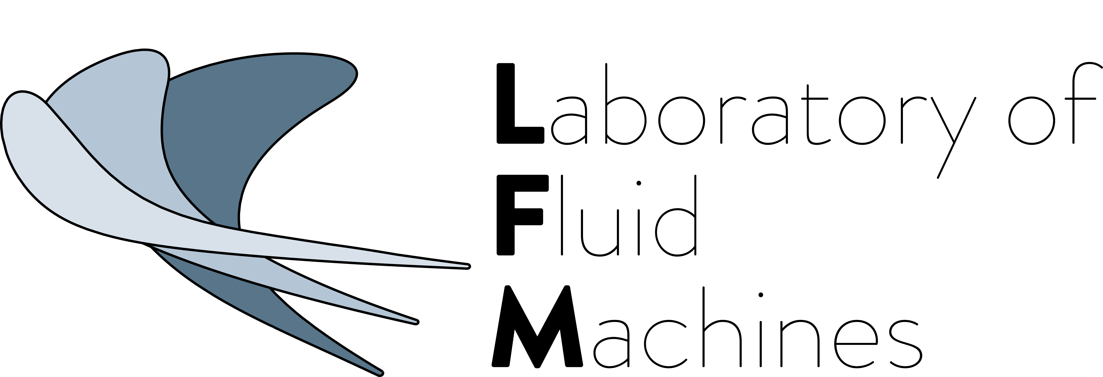
5th International Seminar on ORC Power Systems
September 9-11, 2019, Athens, Greece
THE ROLE OF OPERATIONAL VARIABILITY
ON THE NON-IDEAL FLOW IN SUPERSONIC TURBINES
FOR SUPERCRITICAL ORGANIC RANKINE CYCLES
Alessandro Romei | Davide Vimercati | Alberto Guardone | Giacomo Persico

Slide 2
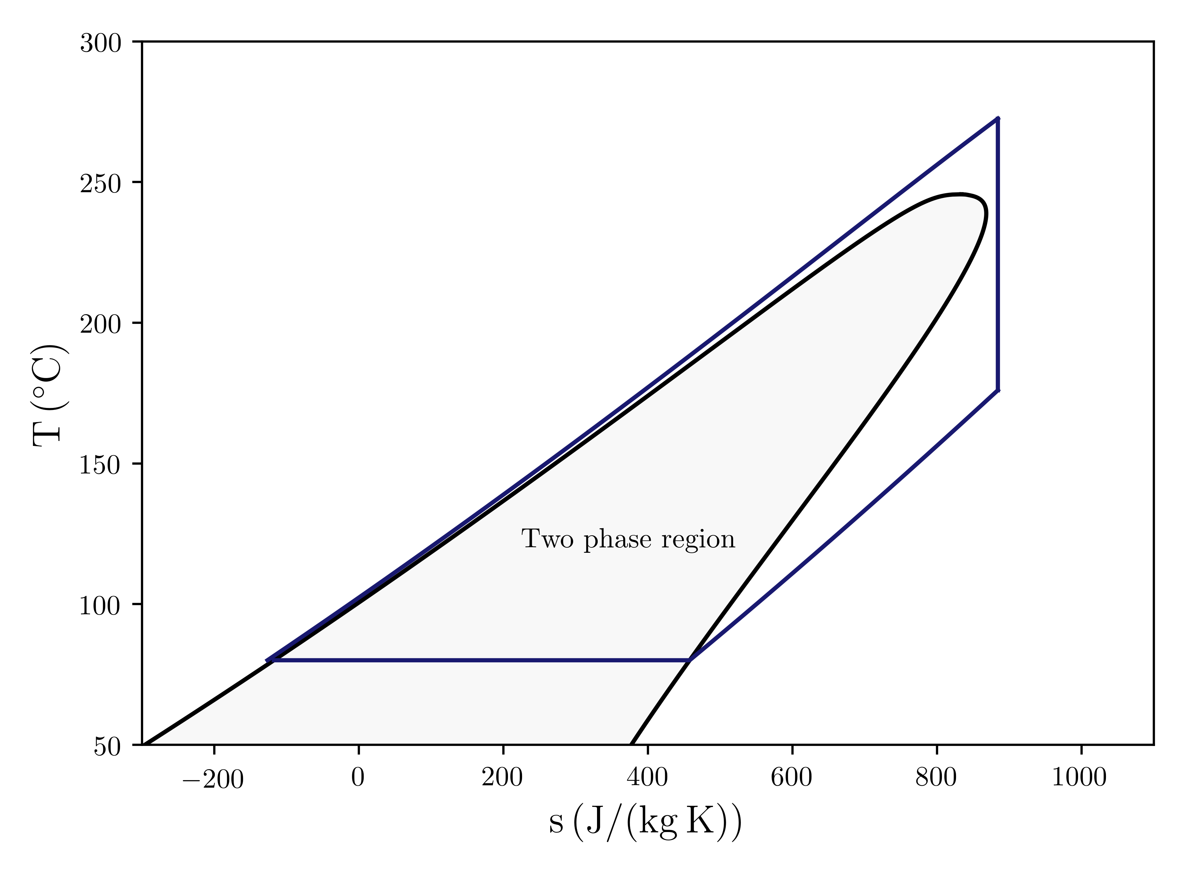
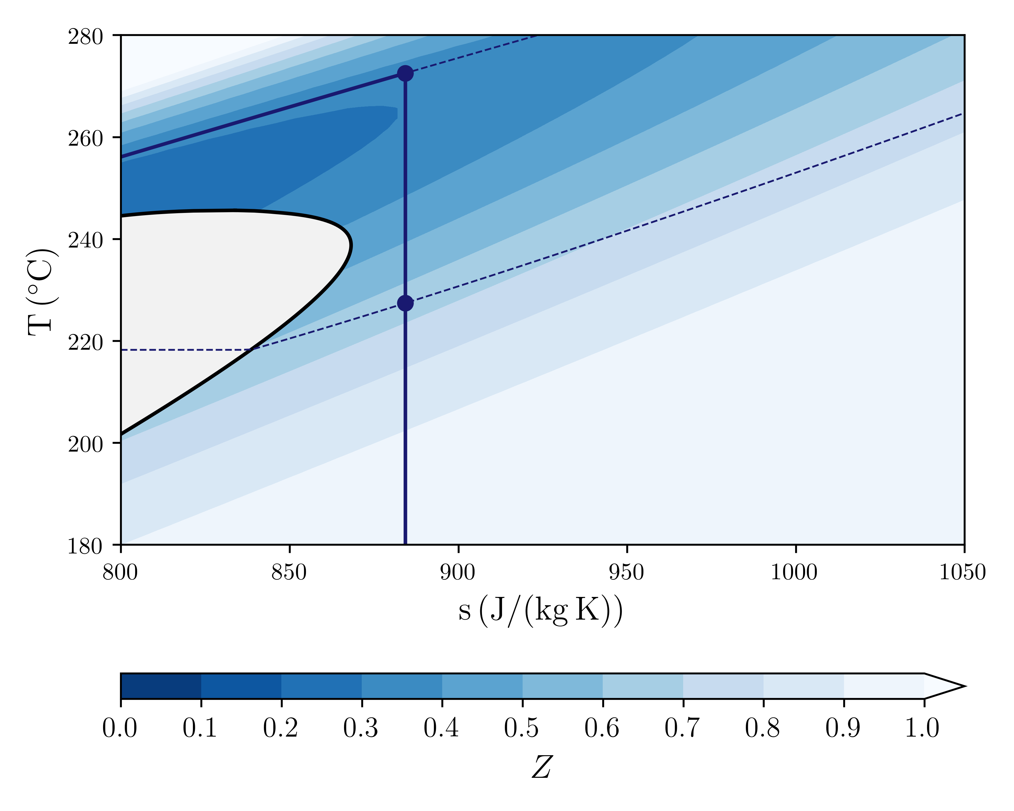
motivation – supercritical ORC systems
4
Possible advantages
Higher cycle efficiency
Higher specific work
Lower Primary Heat Exchanger dimension
T (K)
5
3
6
2
but…
complex thermodynamic region
1
s (J/(kg K))
1
4
Compressibility factor
$$Z$$
$$Z=\frac{Pv}{RT}$$
4*
0

Slide 3
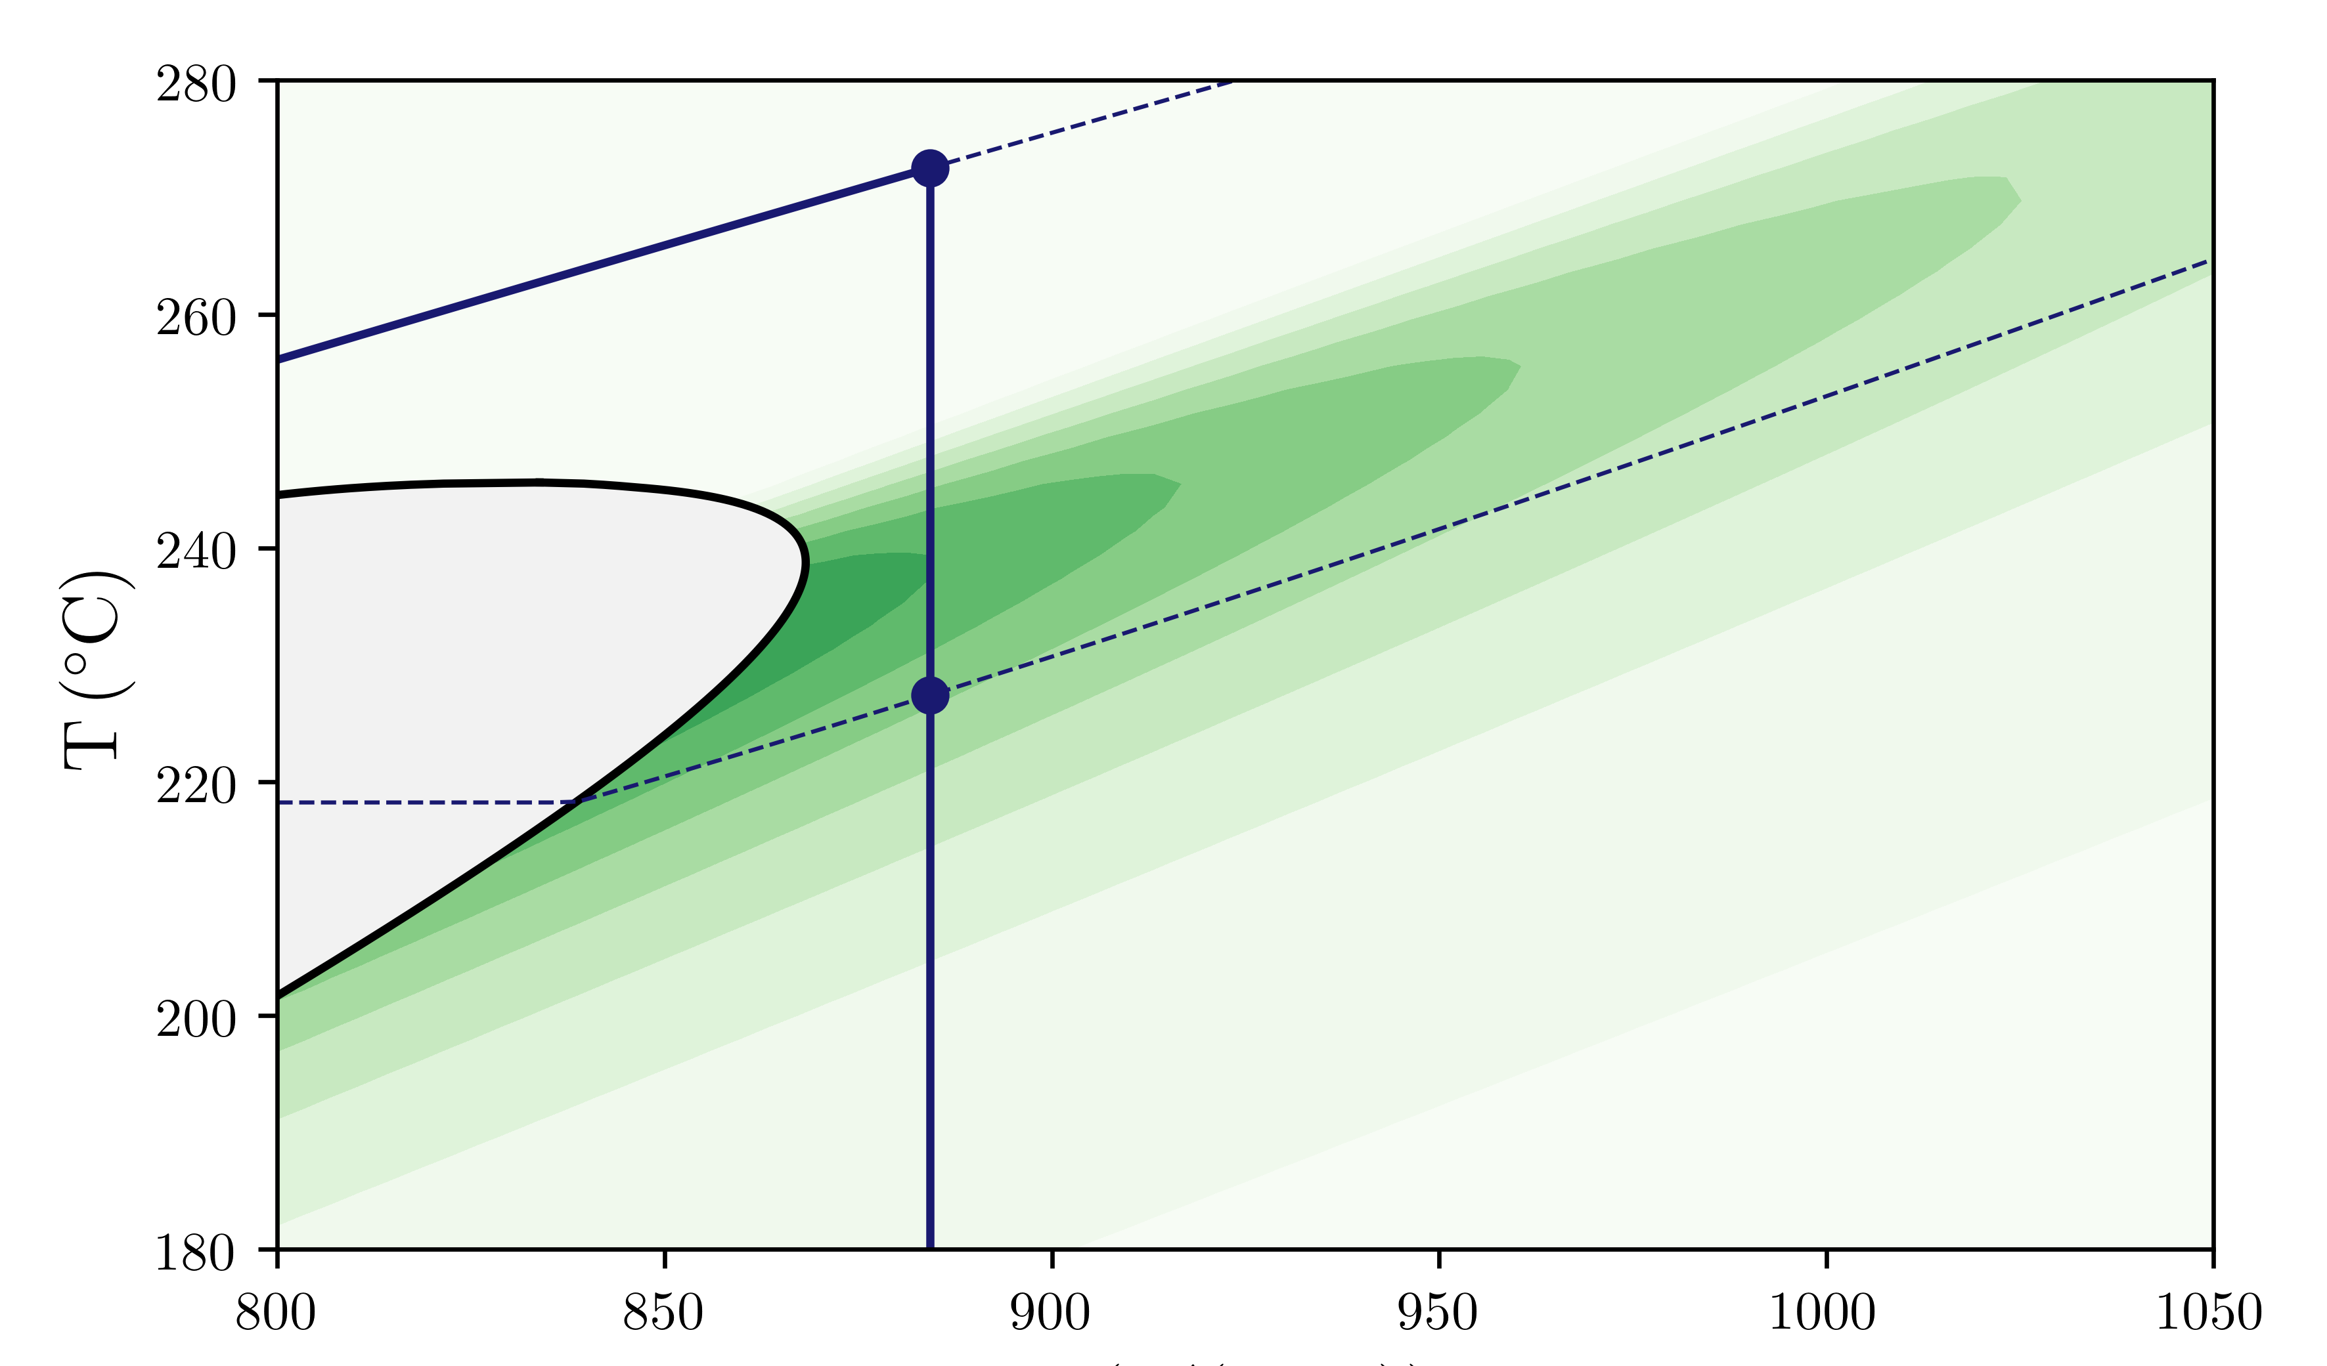
motivation – supercritical ORC systems
4
Possible advantages
Higher cycle efficiency
Higher specific work
Lower Primary Heat Exchanger dimension
T (K)
5
3
6
2
but…
complex thermodynamic region
1
s (J/(kg K))
1
4
Fundamental derivative of gasdynamics
$$Γ$$
$$Γ=1+\frac{ρ}{c}{\left(\frac{∂ρ}{∂c}\right)}_{s}$$
4*
0

Slide 4
gasdynamic regime based on $Γ$
Non-monotonic Mach number
Non-ideal oblique shocks
Strong variation of nozzle area with upstream quantities
M
M
A/A*
P/P_{C}
ϑ (°)
P/P_{C}

Slide 5
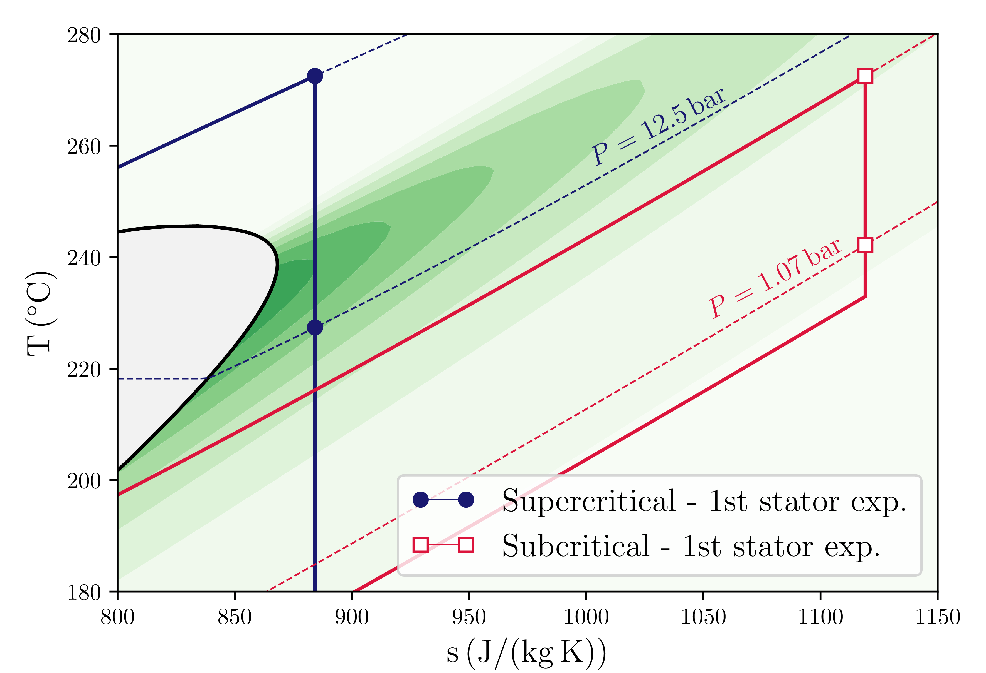
research questions
Does $Γ$ trigger non-conventional turbine operations?
P = 40 bar
1
FLUID: MM
P = 8 bar
$$Γ$$
0
If so, does $Γ$ affect in-field turbine operations?
Design Pressure
Real Pressure

Slide 6
research questions
Does $Γ$ trigger non-conventional turbine operations?
P = 40 bar
1
FLUID: MM
P = 8 bar
$$Γ$$
0
If so, does $Γ$ affect in-field turbine operations?
Design Pressure
Real Pressure

Slide 7
operating regime
IDEAL-LIKE
$$Γ≲1$$

Slide 8
operating regime
IDEAL-LIKE
$$Γ≲1$$
NON-IDEAL
$$Γ≪1$$

Slide 9
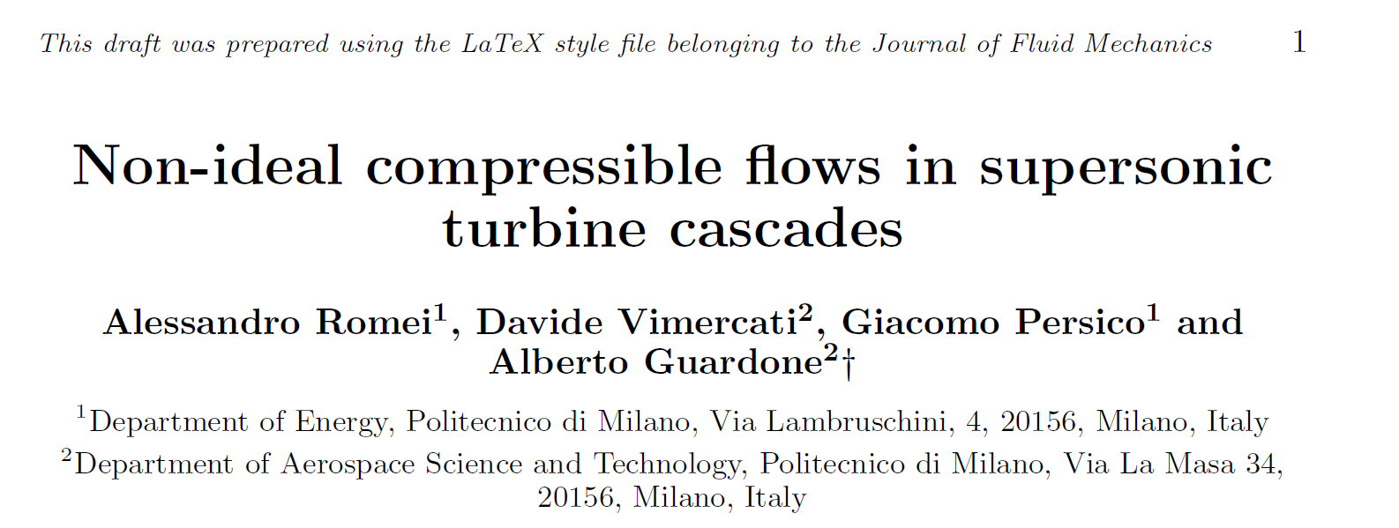
Journal of Fluid Mechanics (JFM)
NON-IDEAL
$$Γ≪1$$

Slide 10
research questions
Does $Γ$ trigger non-conventional turbine operations?
P = 40 bar
1
FLUID: MM
P = 8 bar
$$Γ$$
0
If so, does $Γ$ affect in-field turbine operations?
Design Pressure
Real Pressure

Slide 11
uncertainty quantification – input distribution
$$P_{0}^{t}, T_{0}^{t}$$
$$±2\text{.5 }\text{°}\text{C}$$
$$\text{272}\text{.}\text{5} \text{°}\text{C}$$
Upstream Total Temperature $T_{0}^{t}$
$$P_{1}$$
39.5 bar
40 bar
40.5 bar
Upstream Total Pressure $P_{0}^{t}$
Periodic BCs
$±0.1$bar
$$\text{12.5 }\text{bar}$$
Downstream Static Pressure $P_{1}$

Slide 12
uncertainty quantification – output distribution
Uncertainty
Propagation
Solver
$$±2\text{.5 }\text{°}\text{C}$$
$$\text{272}\text{.}\text{5} \text{°}\text{C}$$
Upstream Total Temperature $T_{0}^{t}$
Polynomial
Chaos
Representation
Cascade Loss Y
39.5 bar
40 bar
40.5 bar
Upstream Total Pressure $P_{0}^{t}$
CFD
Flow Solver
Mass Flow $\dot{m}$
$±0.1$bar
$$\text{12.5 }\text{bar}$$
Downstream Static Pressure $P_{1}$

Slide 13
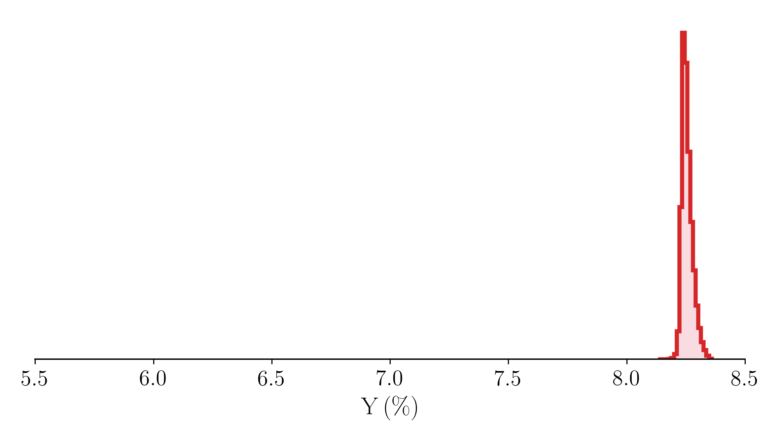
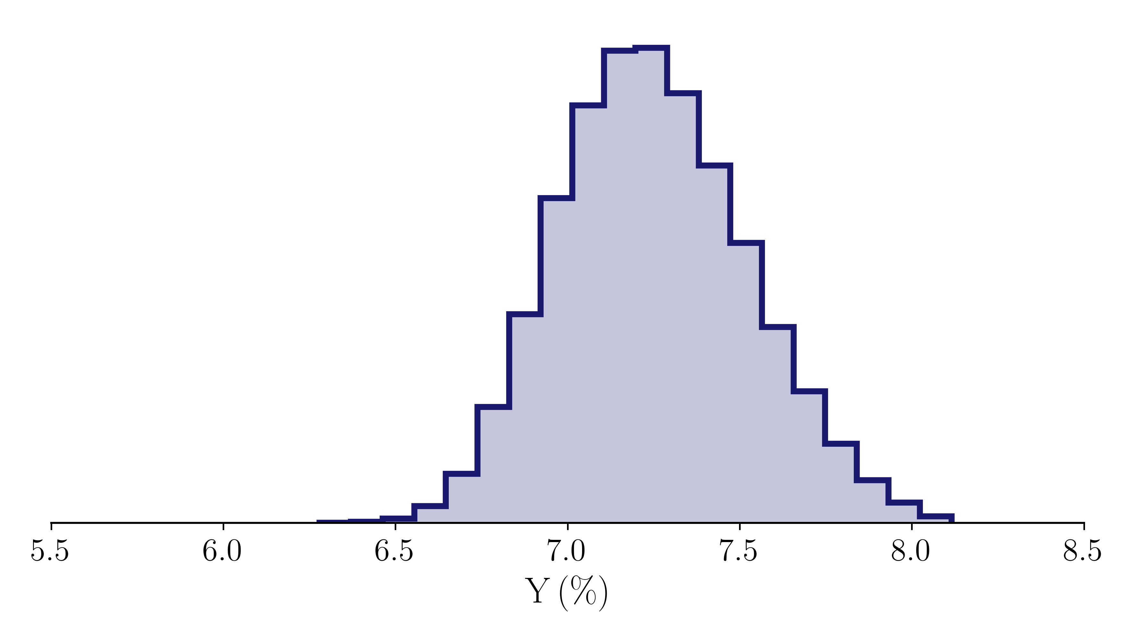
cascade loss variations
IDEAL-LIKE
$$Γ≲1$$
$ΔY=$0.15%pts
NON-IDEAL
$$Γ≪1$$
$ΔY=$1.5%pts

Slide 14
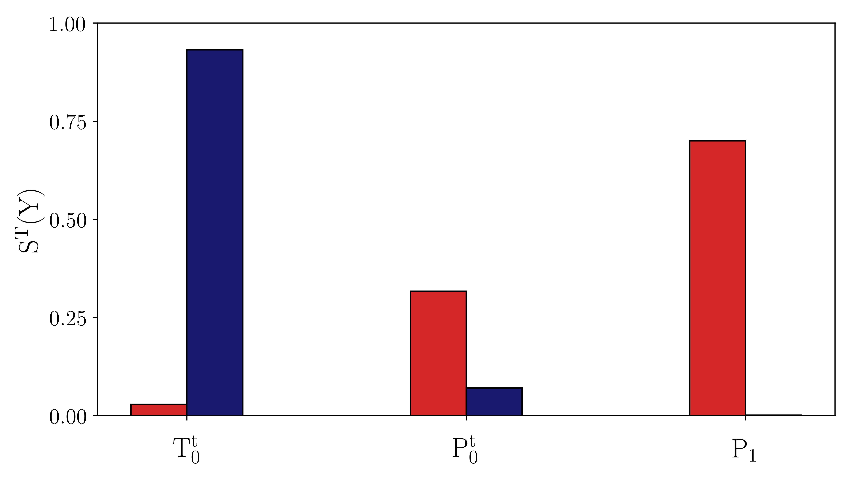
influence of input uncertainties on cascade losses
Ideal-like $Γ≲1$
Non-ideal $Γ≪1$
Importance

Slide 15
mass flow and loss variations
0.2%
2.0%
mass flow
3.0%
mass flow
12.0%
cascade loss
cascade loss
IDEAL-LIKE
$$Γ≲1$$
NON-IDEAL
$$Γ≪1$$

Slide 16
conclusion
DIFFERENT TURBOMACHINERY OPERATIONS BASED ON $Γ$
IDEAL-LIKE
$$Γ≲1$$
NON-IDEAL
$$Γ≪1$$

Slide 17
conclusion
DIFFERENT TURBOMACHINERY OPERATIONS BASED ON $Γ$
CASCADE LOSS VARIES 10 TIMES MORE WHEN $Γ≪1$ $(±0.75\%$ for $Γ≪1$ against $±0.075\%$ for $Γ≲1)$
$ΔY=$0.15%pts
$ΔY=$1.5%pts

Slide 18
conclusion
DIFFERENT TURBOMACHINERY OPERATIONS BASED ON $Γ$
CASCADE LOSS VARIES 10 TIMES MORE WHEN $Γ≪1$ $(±0.75\%$ for $Γ≪1$ against $±0.075\%$ for $Γ≲1)$
UPSTREAM TOTAL TEMPERATURE RULES THESE VARIATIONS
Ideal-like $Γ≲1$
Non-ideal $Γ≪1$
Importance

Slide 19
THE ROLE OF OPERATIONAL VARIABILITY ON THE NON-IDEAL FLOW IN SUPERSONIC TURBINES
FOR SUPERCRITICAL ORGANIC RANKINE CYCLES
Alessandro Romei*
Davide Vimercati
Alberto Guardone
Giacomo Persico
*Laboratory of Fluid Machines
Energy Department | Politecnico di Milano
Via Lambruschini 4, 20156 Milano (IT)
Mail: alessandro.romei@polimi.it
ANY
QUESTIONS?

