Slide 1
PARTIAL ADMISSION EFFECTS ON THE FLOW FIELD OF AN ORC TESLA TURBINE
Leonardo Pacini¹, Lorenzo Ciappi¹, Lorenzo Talluri¹, Daniele Fiaschi¹, Giampaolo Manfrida¹ and Jacek Smolka²
¹Department of Industrial Engineering (DIEF)
University of Florence
Florence, Italy
lorenzo.talluri@unifi.it
²Institute of Thermal Technology, Silesian University of Technology,
Konarskiego 22, Gliwice, Poland

Slide 2
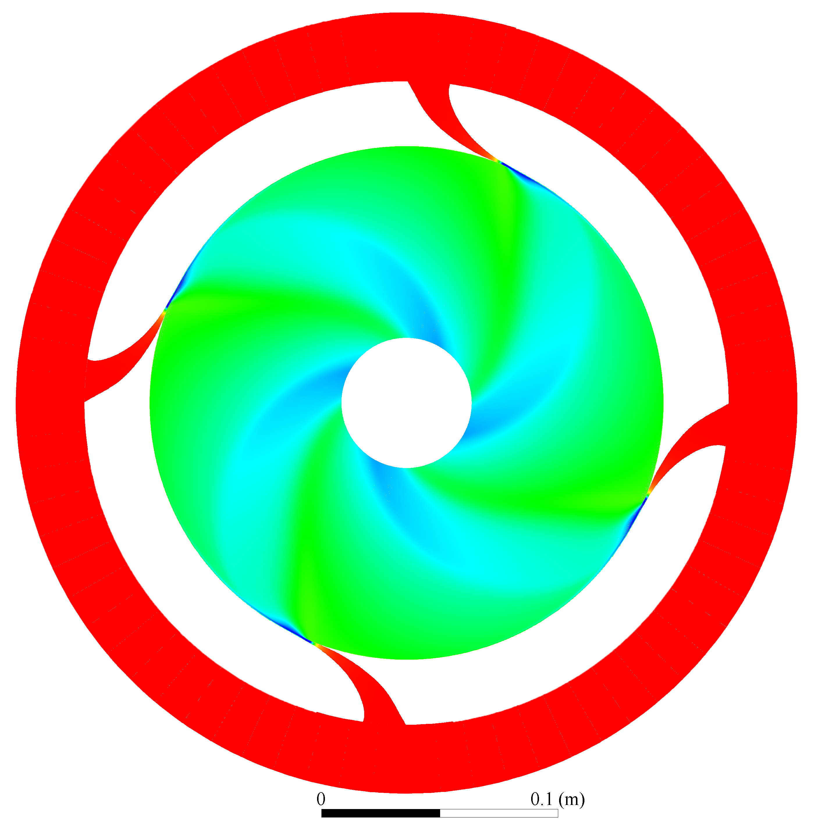
Table of contents
Tesla turbine
2D model
3D model
Rotor flow interpretation
Reference sections
Flow distortion at rotor inlet
Performance assessment
Conclusions

Slide 3
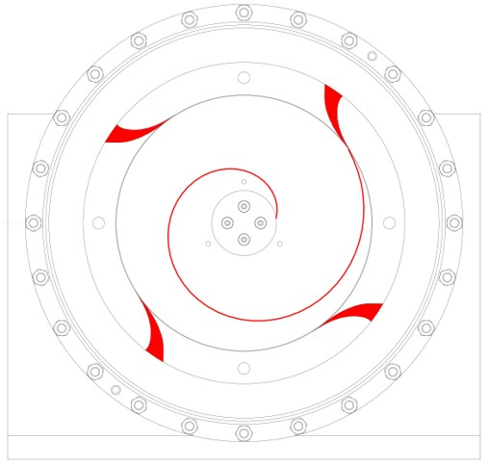
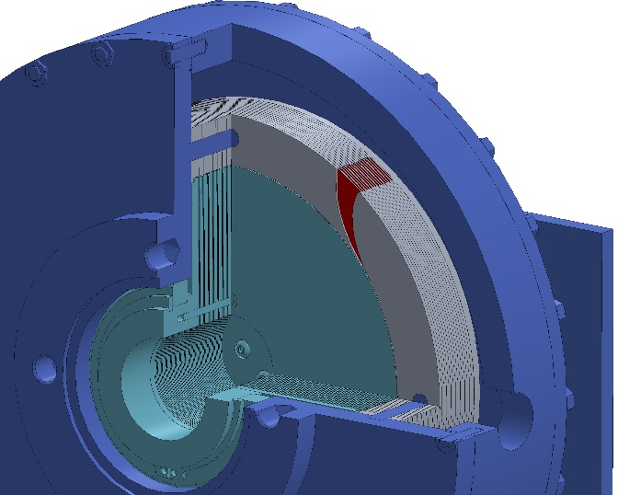
Tesla turbine
The Tesla turbine is a bladeless turbine, comprised of one or more nozzles that direct the working fluid as much tangential as possible at rotor inlet.
The rotor is composed of several stacked parallel disks, assembled very close each other, forming very tight gaps, enabling work exchange between the fluid and the disks through viscous effects.
The fluid enters from the outer radius of the rotor, and depicts a spiral path before exiting through the rotor inner radius
Admission to
plenum chamber
Nozzles
Plenum chamber
Rotor
Fluid Trajectory
inside the rotor
Fluid discharged
axial direction

Slide 4
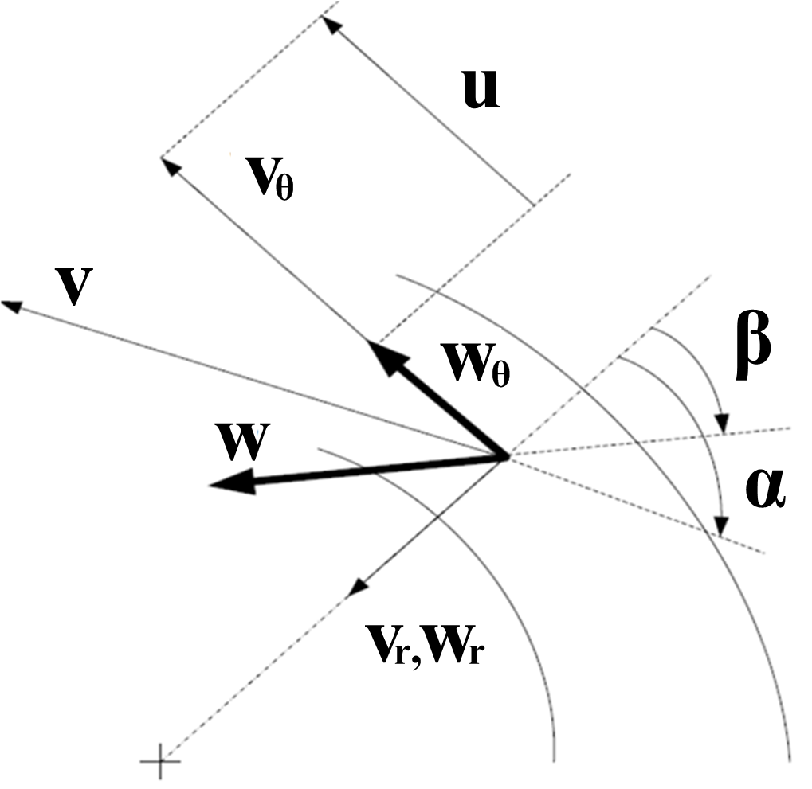
2D model
The model hypothesizes the fluid as real and compressible with steady and viscous flow.
Tangential relative velocity
$\frac{∂w_{θ}}{∂r}= −\frac{10}{a}Ω −\left(\frac{60ν}{w_{r}ab^{2}}+\frac{1}{r}\right)∙ w_{θ}$
Pressure gradient in radial direction
$\frac{1}{ρ}\frac{dp}{dr}= − w_{r}\frac{∂w_{r}}{∂r}∙\frac{a^{2}}{30}+Ω^{2}r+ 2Ωw_{θ}\frac{a}{6}+ \frac{w_{θ}^{2}}{r}∙\frac{a^{2}}{30}−νw_{r}∙\frac{2a}{b^{2}}$

Slide 5
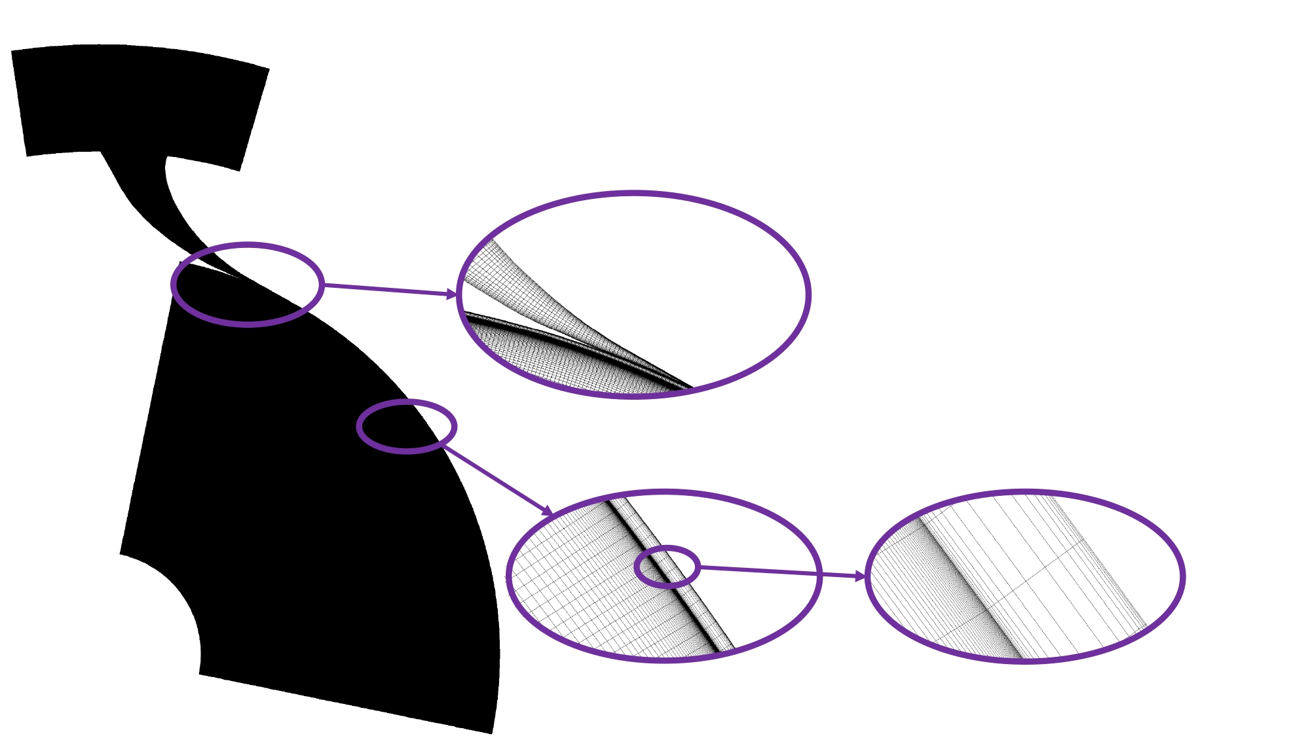
3D model
Boundary Conditions
rpm | Total inlet pressure [Pa] | Total inlet temperature [°C] | Static outlet pressure [Pa] | Static outlet temperature [°C]
3 000 | 493133 | 72.66 | 311778 | 66.72
R1233zd(E)
Langtry-Menter transitional shear stress transport model

Slide 6
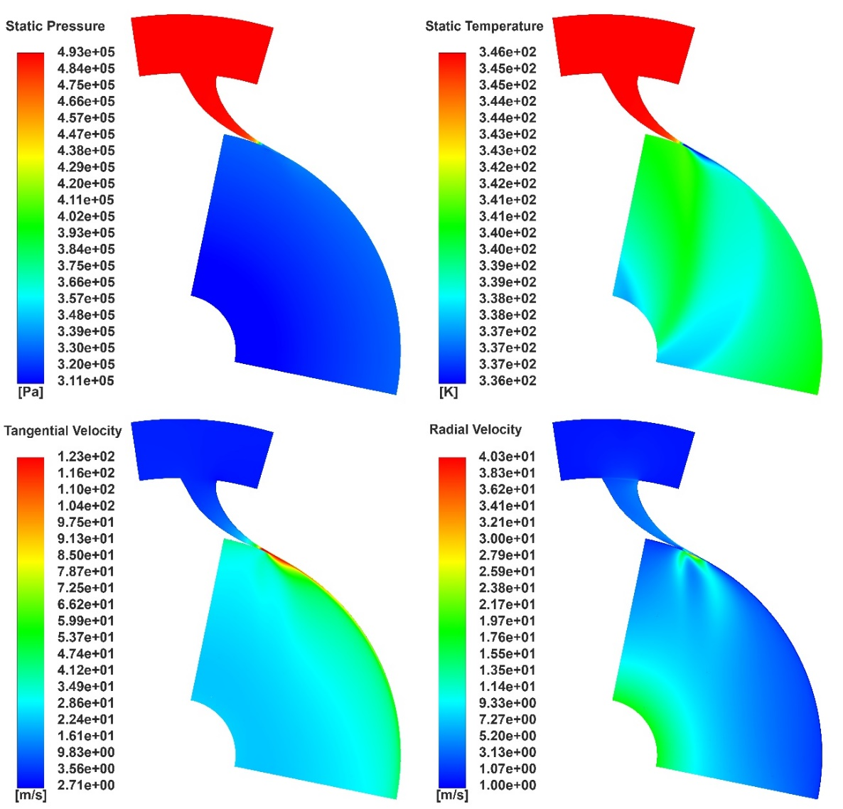
Rotor flow interpretation
Temperature distribution inside the rotor is not uniform, but it displays clearly four different temperature regions, which are due to the spiral trajectories of the fluid from the four nozzle admissions
Total pressure drop in the rotor is of about 30 kPa, which is a very small portion of the total pressure drop of about 180 kPa, which is mainly produced by the stator (146 kPa)
the Tesla turbine works
similarly to an action turbine.

Slide 7
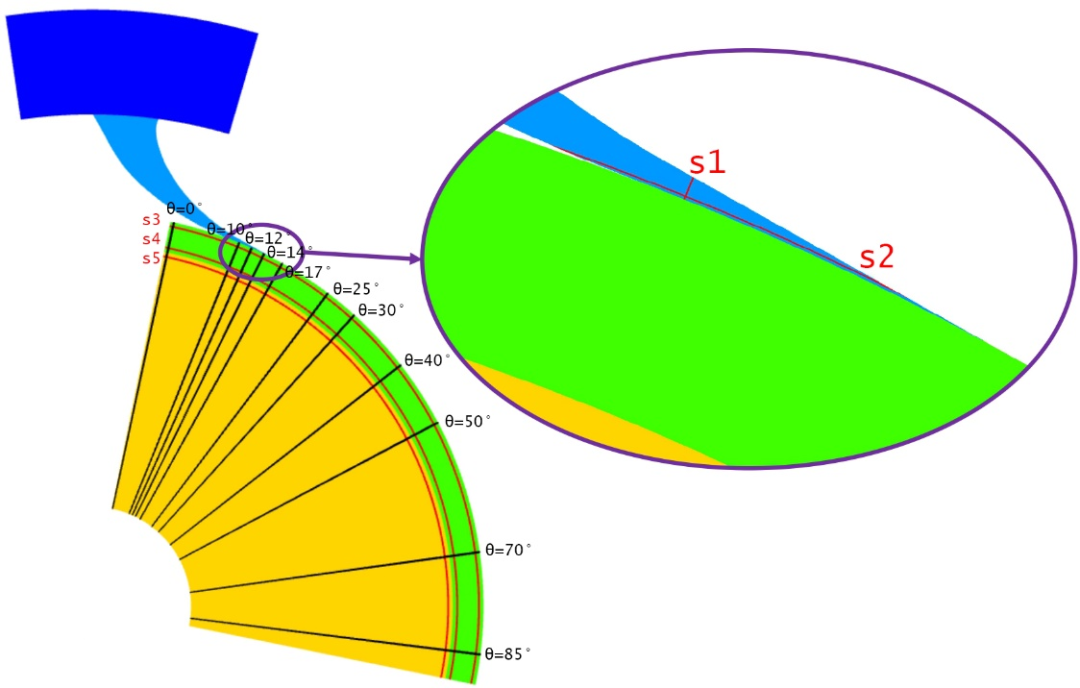
Reference sections
5 reference sections are selected within the domain:
s₁ (throat)
s₂ (stator outlet)
s₃ (stator-rotor gap inlet)
s₄ (stator-rotor gap outlet)
s₅ (rotor inlet).
Trends of the main variables were also evaluated along the tangential direction (θ)

Slide 8
Flow distortion at rotor inlet
Drastic decrease of the absolute velocity magnitude is present in the gap between stator and rotor (s₃-s₄)
Viscous flow effects and flow entrainment in the gap produce an increase of the static temperature at rotor inlet of about 2-3 K
Radial velocity fluctuating trend is due to an adjustment of flow direction: the flow progressively loses its tangential behavior

Slide 9
Flow distortion at rotor inlet
The total pressure and flow velocities present high peaks in the region of the nozzle exit; also the temperature in correspondence to the velocity field distortion presents a significant drop.
The distribution of static pressure is less influenced by the partial admission

Slide 10
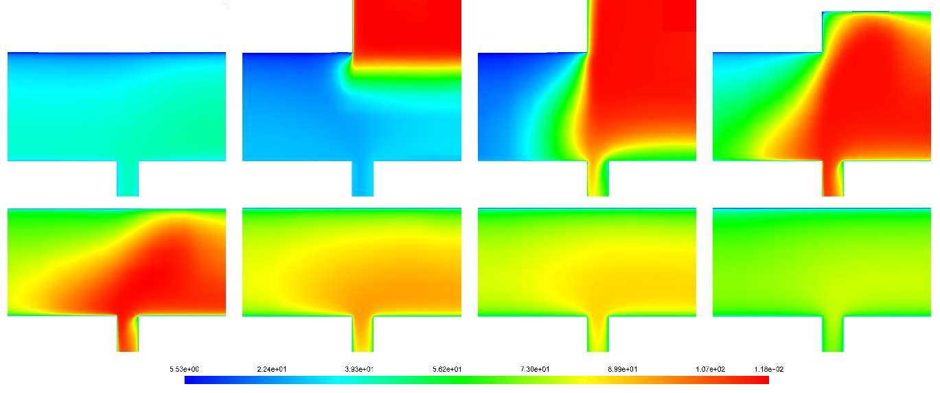
Flow distortion at rotor inlet
An asymmetric flow at rotor inlet and an intensified effect in the admission region is noticeable
Proceeding far from the admission (θ<10; θ>25), the flow field become symmetric.
θ=0°
θ=10°
θ=12°
θ=14°
θ=17°
θ=25°
θ=30°
θ=40°

Slide 11
Performance assessment
rpm | Total mass flow rate [kg/s] | Rotor efficiency | Turbine efficiency | Power per channel [W] | Total power [W]
2-D EES model
3000 | 0.242 | 0.51 | 0.29 | 9.57 | 574.3
3-D CFD model
3000 | 0.242 | 0.50 | 0.28 | 9.52 | 571.3
The power prediction between 2-D code and 3-D computational fluid dynamics is really close, both in terms of power and efficiency.
=> the distortion of the flow field does not considerably influence the performance of the turbine in terms of power and efficiency when mass weighted average values are considered.

Slide 12
A 29% turbine efficiency for a 0.57 kW expander was obtained.
Stator–rotor interaction simulations allowed understanding the flow features due to partial admission. Especially, temperature was found to be the variable most influenced by the flow distortion, developing streaks of different temperature in tangential direction.
Stator–rotor coupled simulations carried out with 3-D CFD do not affect the prediction of work and efficiency, if compared to simulations done with the 2-D EES in-house tool on the rotor. Nonetheless, they allow for a more detailed investigation of the critical points of the expander, such as the nozzle outlet operation and the influence of the gap.

Slide 13
PARTIAL ADMISSION EFFECTS ON THE FLOW FIELD OF AN ORC TESLA TURBINE
Leonardo Pacini¹, Lorenzo Ciappi¹, Lorenzo Talluri¹, Daniele Fiaschi¹, Giampaolo Manfrida¹ and Jacek Smolka²
¹Department of Industrial Engineering (DIEF)
University of Florence
Florence, Italy
lorenzo.talluri@unifi.it
²Institute of Thermal Technology, Silesian University of Technology,
Konarskiego 22, Gliwice, Poland

