Slide 1

5th International Seminar on ORC Power Systems, Athens Greece, 9-11 September 2019
Off-Design Analysis of Organic Rankine Cycle Integrated with Proton Exchange Membrane Fuel Cell (PEMFC)
9 September 2019
Hong Wone Choi, Jin Young Park, Dong Kyu Kim, Min Soo Kim
Seoul National University, South Korea

Slide 2






Overview
Backgrounds and Objective
Thermal Management for PEMFC
PEMFC-ORC Hybrid Power System
Results and Discussions
Conclusions

Slide 3
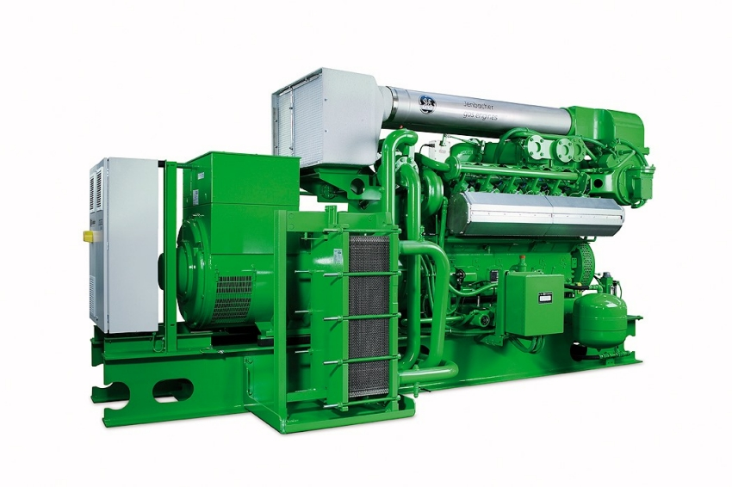
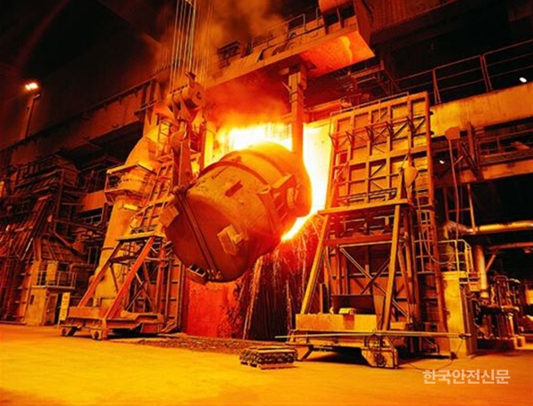
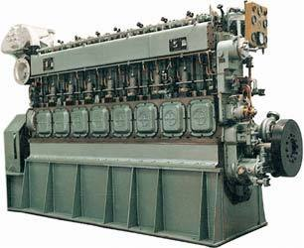
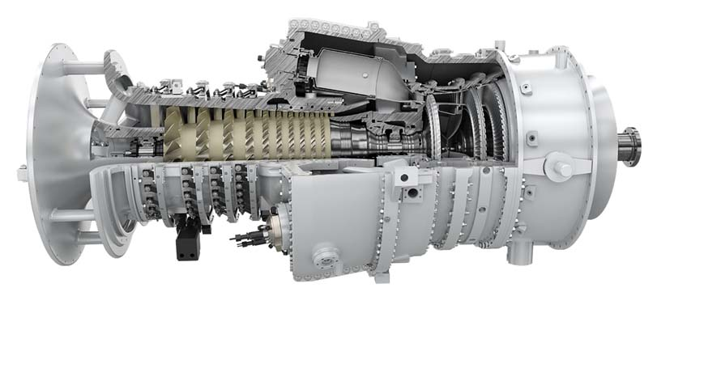
Conventional Waste Heat Recovery (WHR) Applications
Backgrounds and Objective
Low evaporation temperature and pressure
Less heat is needed during evaporation
Diesel engine
Industrial plant
High stability regardless of part-load / off-design operation
Superheating is not essential
Marine engine
Gas turbine
ORC is practical solution for enhancing energy efficiency
Reference
Bertrand F. et al., 2011, Renewable and Sustainable Energy Reviews, 15: 3963-3979
E. Macchi and M. Astolfi, 2017, Woodhead Publishing, pp. 613-627

Slide 4
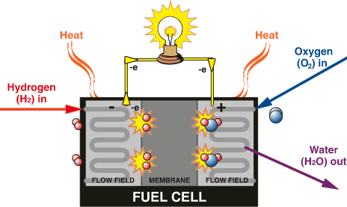
Proton Exchange Membrane Fuel Cell (PEMFC)
Backgrounds and Objective
Pros
Environment-friendly
Infinite fuel resource (H₂)
Few moving parts and silent
Cons
High fuel cost (H₂)
Efficiency degradation as electric load increases
Need to increase energy efficiency

Slide 5

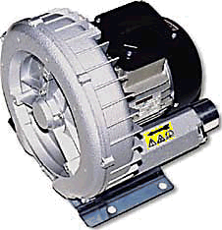
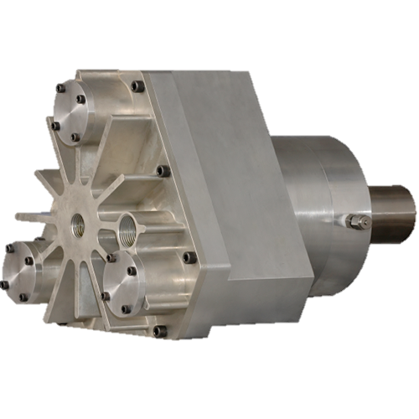

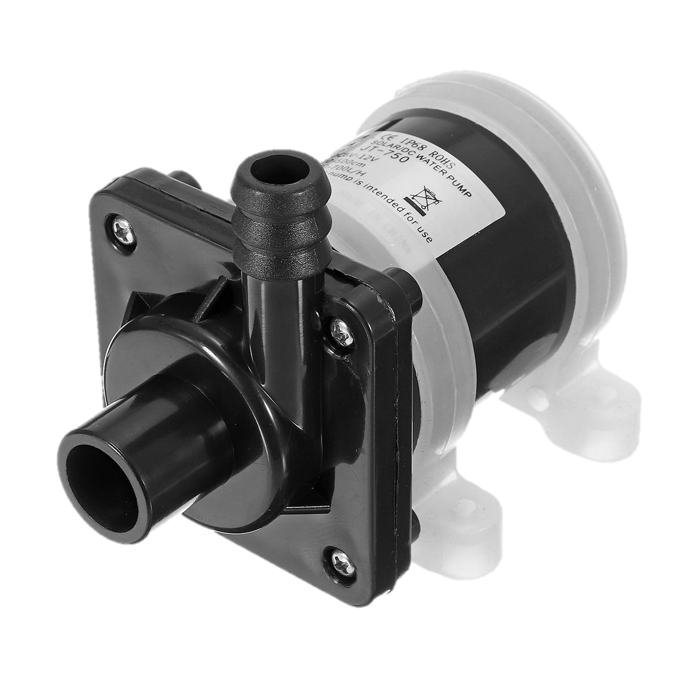
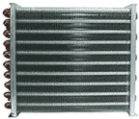
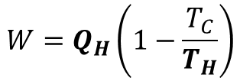
Backgrounds and Objective
Influence of Heat Source Condition
The topping fuel cell
Objective
Stack
Correlation of temperature and waste heat
Off-design characteristics
Optimal temperature
0
Gear Pump
T_{H}
Q_{H}
$$W=Q_{H}\left(1−\frac{T_{C}}{T_{H}}\right)$$
Evaporator
Expander
Q_{C}
T_{C}
Refrigerant
Pump
Condenser
The bottoming ORC

Slide 6

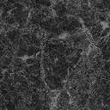
Thermal Management for PEMFC
PEMFC Operating Condition
Assumption
Steady-state regime
Even temperature on membrane
T_{out,fc} = T_{cell}
T_{out,fc} – T_{in,fc} = 6 K
T_{out,fc} =298 K
Relative humidity: ϕ_{H2,in}= ϕ_{air,in}= 100%
$$H_{2}+H_{2}O$$
$$Air+H_{2}O$$
$$Anode bipolar plate$$
$$Anode backing lyaer$$
$$Cathode backing lyaer$$
$$Cathode bipolar plate$$
$$Cooling channel$$
$$Cooling channel$$
$$Membrane$$
Operating condition & PEMFC design
Parameter | Symbol | Value | Unit
Cell temperature | T_{cell} | 343~363 | K
Current density | j_{cell} | 0.7~1.0 | A/cm²
Number of cell | N_{cell} | 50 | EA
Cell’s area | A_{cell} | 200 | cm²
Fig. A cross-section view of single-cell PEMFC
Reference
Choi et al., 2018, International Journal of Hydrogen Energy, 43: 13406-13419

Slide 7








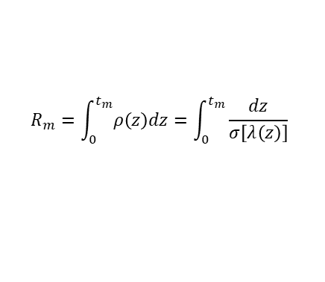
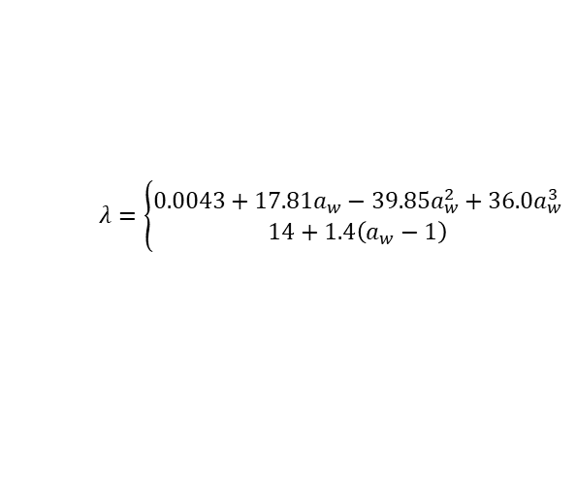


Thermal Management for PEMFC
Electrochemical Theory for PEMFC Modeling
Reversible voltage
$$V_{rev}$$
$$V_{rev}=E^{0}+\frac{Δ\hat{s}}{nF}\left(T_{cell}−T_{ref}\right)−\frac{RT_{cell}}{nF}\ln{\frac{1}{{P_{H_{2}}P}_{O_{2}}^{0.5}}}$$
Waste
heat
Activation voltage loss
$$V_{act}=\frac{RT_{cell}}{αnF}\ln\left(\frac{j}{j_{0}}\right)$$
  Cell voltage (V)
Ohmic voltage loss
$$λ=\left\{\begin{aligned}0.0043+17.81a_{w}−39.85a_{w}^{2}+36.0a_{w}^{3} \\ 14+1.4\left(a_{w}−1\right)\end{aligned}\right.$$
$$\left(0<a_{w}≤1\right)$$
Power
$$\left(1<a_{w}≤3\right)$$
$$λ\left(z\right)=\frac{11α^{∗}}{n_{drag}^{sat}}+C\exp\left(\frac{jM_{m}n_{drag}^{sat}}{22Fρ_{dry}D_{λ}}z\right)$$
  Current density (A/cm²)
$$σ\left(T,λ\right)=σ_{303K}×\exp\left(1268\left(\frac{1}{303}−\frac{1}{T_{cell}}\right)\right)$$
Cell voltage
$$R_{m}=\int_{0}^{t_{m}}{ρ\left(z\right)dz}=\int_{0}^{t_{m}}{\frac{dz}{σ\left[λ\left(z\right)\right]}}$$
$$V_{cell}=V_{rev}−V_{act}−V_{ohm}−V_{conc}$$
$$V_{ohm}=IR_{m}$$
Fuel cell stack power
Concentration voltage loss
$${\dot{W}}_{stack}=N_{cell}V_{cell}(jA_{cell})$$
$$V_{conc}=\frac{RT_{cell}}{αnF}\ln{\frac{c_{R}^{0}}{c_{R}^{∗}}}$$
Reference
R. O’hayre et al., 2016, John Wiley & Sons, pp. 77-200

Slide 8
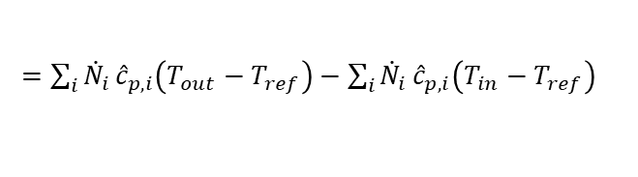

























Thermal Management for PEMFC
Thermal Management System Modeling
$${\dot{W}}_{stack}$$
$${\dot{Q}}_{latent}=\left({\dot{N}}_{H_{2}O\left(l\right)}^{rxn,gen}−{\dot{N}}_{H_{2}O\left(l\right)}^{ca,out}\right)H_{LV}$$
$${\dot{Q}}_{sensible}={\dot{Q}}_{an}^{out}+{\dot{Q}}_{ca}^{out}−{\dot{Q}}_{an}^{in}−{\dot{Q}}_{ca}^{in}$$
$${\dot{Q}}_{fuel}$$
$${\dot{Q}}_{latent}$$
$=\sum_{i}{{\dot{N}}_{i}}{\hat{c}}_{p,i}\left(T_{out}−T_{ref}\right)−\sum_{i}{{\dot{N}}_{i}}{\hat{c}}_{p,i}\left(T_{in}−T_{ref}\right)$
$${\dot{Q}}_{an}^{in}$$
$${\dot{Q}}_{ca}^{in}$$
$${\dot{Q}}_{amb}=UA(T_{cell}−T_{ref})$$
Mass conservation
$${\dot{Q}}_{cool}$$
$${\dot{N}}_{H_{2}}^{an,in}=λ_{an}\frac{I}{2F}$$
$${\dot{N}}_{H_{2}}^{an,out}=(λ_{an}−1)\frac{I}{2F}$$
$${\dot{N}}_{H_{2}O\left(l\right)}^{rxn,gen}=\frac{I}{2F}$$
$${\dot{Q}}_{an}^{out}$$
$${\dot{Q}}_{ca}^{out}$$
$${\dot{N}}_{O_{2}}^{ca,in}=λ_{ca}\frac{I}{4F}$$
$${\dot{N}}_{O_{2}}^{ca,out}={(λ}_{ca}−1)\frac{I}{4F}$$
$${\dot{Q}}_{amb}$$
$${\dot{N}}_{H_{2}O(v)}^{an,in}=\left(\frac{P_{sat}φ}{P_{an}−P_{sat}}\right)λ_{an}\frac{I}{2F}$$
$${\dot{N}}_{H_{2}O\left(v\right)}^{ca,in}=\left(\frac{P_{sat}φ}{P_{ca}−P_{sat}}\right)λ_{ca}\frac{I}{4F}×\frac{1}{0.21}$$
Energy conservation
$${\dot{N}}_{H_{2}O(v)}^{an,out}=\left(\frac{P_{sat}φ}{P_{an}−P_{sat}}\right)(λ_{an}−1)\frac{I}{2F}$$
$${\dot{Q}}_{cool}={\dot{Q}}_{fuel}−{\dot{W}}_{stack}−{\dot{Q}}_{loss}$$
$${\dot{N}}_{H_{2}O\left(v\right)}^{ca,out}=\left(\frac{P_{sat}φ}{P_{ca}−P_{sat}}\right)(\frac{1}{0.21}λ_{ca}−1)\frac{I}{4F}$$
$${\dot{W}}_{stack}=N_{cell}V_{cell}(jA_{cell})$$
$$I_{stack}$$
$${\dot{Q}}_{loss}={\dot{Q}}_{latent}+{\dot{Q}}_{sensible}+{\dot{Q}}_{amb}$$
$${\dot{N}}_{H_{2}O\left(l\right)}^{ca,out}={\dot{N}}_{H_{2}O(v)}^{an,in}+{\dot{N}}_{H_{2}O\left(v\right)}^{ca,in}+{\dot{N}}_{H_{2}O\left(l\right)}^{rxn,gen}−{\dot{N}}_{H_{2}O\left(v\right)}^{an,out}−{\dot{N}}_{H_{2}O\left(v\right)}^{ca,out}$$
Reference
X. Zhao et al., 2015, International Journal of Hydrogen Energy, 40: 3048-3056

Slide 9
PEMFC-ORC Hybrid Power System
Methodology
Fig. Schematic diagram for the hybrid power system

Slide 10
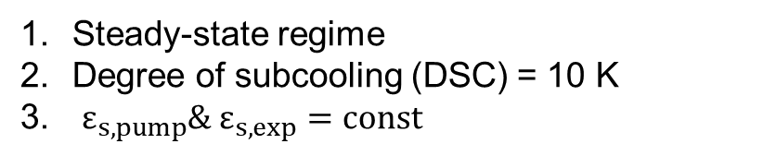
PEMFC-ORC Hybrid Power System
ORC Operating Condition
Assumption
Steady-state regime
Degree of subcooling (DSC) = 10 K
$ε_{s,pump}\& ε_{s,exp}=const$
Evaporator
Operating condition & ORC system design
Expander
Refrigerant
Pump
Parameter | Symbol | Value | Unit
Mass flow rate of system | m_{orc} | 0.01~0.04 | kg/s
Mass flow rate of heat sink | m_{sink} | 0.35 | kg/s
Temperature of heat sink | T_{sink} | 298 | K
Number of plate of evaporator | N_{evap} | 32 | EA
Heat transfer area of evaporator | A_{evap} | 780 | cm²
Number of plate of condenser | N_{cond} | 50 | EA
Heat transfer area of condenser | A_{cond} | 471 | cm²
Receiver
Condenser
Chiller
Fig. Description for the bottoming ORC system

Slide 11






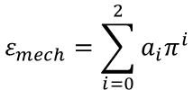










PEMFC-ORC Hybrid Power System
Components Modeling
Pressure drop
Heat exchanger
Brazed Plate Heat Exchanger (BPHE)
Pressure drop
$$∆P=f\frac{L}{D}\frac{ρV^{2}}{2}$$
Single-phase heat transfer
(Muley et al., 1999)
$$\frac{1}{f^{1/2}}≈−1.8\log\left[\frac{6.9}{Re_{d}}+{\left(\frac{ε/d}{3.7}\right)}^{1.11}\right]$$
$$Nu=CRe^{1/2}{Pr}^{1/3}$$
Two-phase heat transfer
Pump
Evaporation
(Desideri et al., 2017)
$Ω$: dimensionless pump speed
$${\dot{W}}_{p}=\frac{∆P{\dot{m}}_{r}}{ρ_{r}η_{p}}$$
$ϕ$: dimensionless impeller diameter
$h_{bo}=1.48×{10}^{3} We^{−3.22e−2}{\left(\frac{ρ_{l}}{ρ_{v}}\right)}^{−3.38e−1}{Re}_{l}^{4.51e−1}Bd^{−4.69e−1}$
$$ε_{pump}=0.15$$
Flow rate ratio
$$θ=Ω φ^{3}$$
Condensation
(Yan et al., 1999)
Pressure ratio
$$π=Ω^{2}φ^{2}$$
$${Nu}_{co}=4.118 {Re}_{eq}^{0.4}{Pr}_{l}^{0.3}$$
Expander
$$\frac{1}{UA}=\frac{1}{{\left(hA\right)}_{h}}+\frac{1}{{\left(hA\right)}_{c}}+\frac{t_{plate}}{{\left(kA\right)}_{plate}}$$
${\dot{W}}_{exp}=ε_{exp}{\dot{m}}_{r}{\left(i_{i}−i_{o}\right)}_{exp}$
$$ε=\frac{1−\exp\left[−\left(1−R\right)NTU\right]}{1−R\exp\left[−\left(1−R\right)NTU\right]}$$
$$ε_{exp}=ε_{isen}ε_{mech}$$
$$ε_{mech}=\sum_{i=0}^{2}{a_{i}π^{i}}$$
For counter-flow arrangement
$$ε_{isen}=0.82$$
Reference
A. Desideri et al., 2017, International journal of heat and mass transfer, 113: 6-21
Y. Y. Yan et al., 1999, International journal of heat an mass transfer, 42: 993-1006
A. Muley et al., 1999, Journal of Heat Transfer-Transactions of ASME, 121: 1011-1017
$π$: pressure ratio around the expander

Slide 12









Results and Discussions
Thermal Correlation of PEMFC
Governing equations
$${\dot{Q}}_{gen}={\dot{Q}}_{fuel}−{\dot{W}}_{stack}$$
$${\dot{Q}}_{loss}={\dot{Q}}_{latent}+{\dot{Q}}_{sensible}+{\dot{Q}}_{amb}$$
$${\dot{Q}}_{cool}={\dot{Q}}_{gen}−{\dot{Q}}_{loss}$$
Q_{gen}
Q_{loss}
Current density
(A/cm²)
1.0
$$T_{cell}$$
$$T_{evap}$$
0.9
0.8
0.7
$${\dot{Q}}_{cool}$$
$${\dot{Q}}_{evap}$$
(a)
(b)
Topping
PEMFC
Bottoming
ORC
Fig. (a) Total heat generation and heat loss of PEMFC stack (b) heat transferred by coolant with respect to operating cell temperature of PEMFC

Slide 13

Results and Discussions
Heat Input to the Bottoming ORC
$${\dot{Q}}_{cool}≫{\dot{Q}}_{max}$$
Current density increases → Waste heat increases
Cell temperature rise → Waste heat decreases
(Associated with thermal correlation of PEMFC)
Q_{cool,pemfc} >> Q_{max,evap} (343~346 K at 1 A/cm²)
☞ Off-design operation appears
from the low temperature region
as increasing current density.
Evaporator inlet temperature (K)
Fig. Correlation of heat input and inlet temperature of hot fluid at the evaporator

Slide 14
Results and Discussions
Performance of the Bottoming ORC
Off-design
Off-design
Current
density
(A/cm²)
$$33 g/s$$
$$27 g/s$$
$$29 g/s$$
$$23 g/s$$
$$21 g/s$$
$$25 g/s$$
$$19 g/s$$
$$21g/s$$
$$17 g/s$$
$${\dot{m}}_{orc}=17 g/s$$
Evaporator inlet temperature (K)
Evaporator inlet temperature (K)
(a)
(b)
Fig. Performance correlation with heat source temperature in terms of (a) the expander’s power (b) the bottoming ORC’s thermal efficiency
The waste heat → Refrigerant mass flow rate → Power & Efficiency
Low temperature condition restricts the bottoming ORC to achieve higher enhancement at the higher current density regions.

Slide 15


Thermal Management for PEMFC
Performance Enhancement by the Bottoming ORC
Current density
(A/cm²)
Hybrid
PEMFC
Hybrid
PEMFC
1.0
Current density
(A/cm²)
0.9
1.0
0.8
0.9
0.7
0.8
0.7
(a)
(b)
Fig. Performance comparison between hybrid system and PEMFC in terms of (a) power generation (b) energy efficiency
The hybrid systems has the optimal temperature at 353 K in power and efficiency.
The higher the current density, the bigger enhancement can be accomplished.

Slide 16
Conclusion
The characteristics of waste heat from PEMFC
PEMFC generates more waste heat as it operate at higher current densities.
As the operating temperature increases, the amount of heat transferred by coolant decreases due to the rise of heat dissipation by sensible and latent heat.
The performance of the bottoming ORC
As the current density increases, the waste heat can exceed the capacity of the evaporator and cause off-design operation.
Performance enhancement by the bottoming ORC is more effective at the higher operating current density, the lower temperature.
The optimal performance of the hybrid power system
The suggested hybrid system has the best performance operating at 353 K in terms of both energy efficiency and power generation.
Considering the off-design operation, the current density are allowed to be increased until the evaporator can cover the amount of heat at the optimum temperature (353 K in this study).

Slide 17
Q & A
Thank you

